Slide 1
Contact Swap
Capstone Project 2014
Michael Haufe <mlhaufe@uwm.edu>
Anthonie Roux <aroux@uwm.edu>
Sean McClanahan <mcclana5@uwm.edu>
Kwok-ho Lo <kwokholo@uwm.edu>

Slide 2
Overview
Contact Swap is an android application that makes it quick and easy to exchange your contact information with anyone you meet. Just touch the phone of your nearest friend's phone and you're double plus friends!

Slide 3
Importing The Project
Android SDK, Git

Slide 4
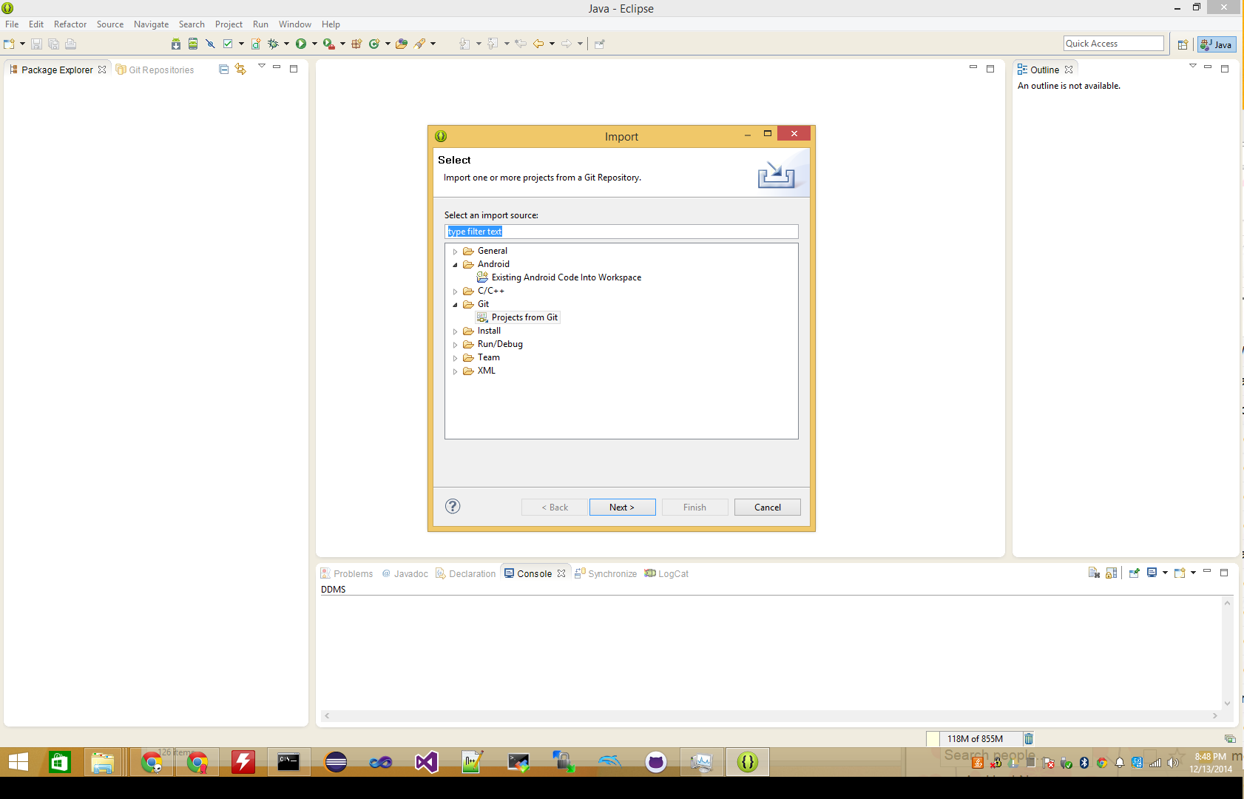

Slide 5
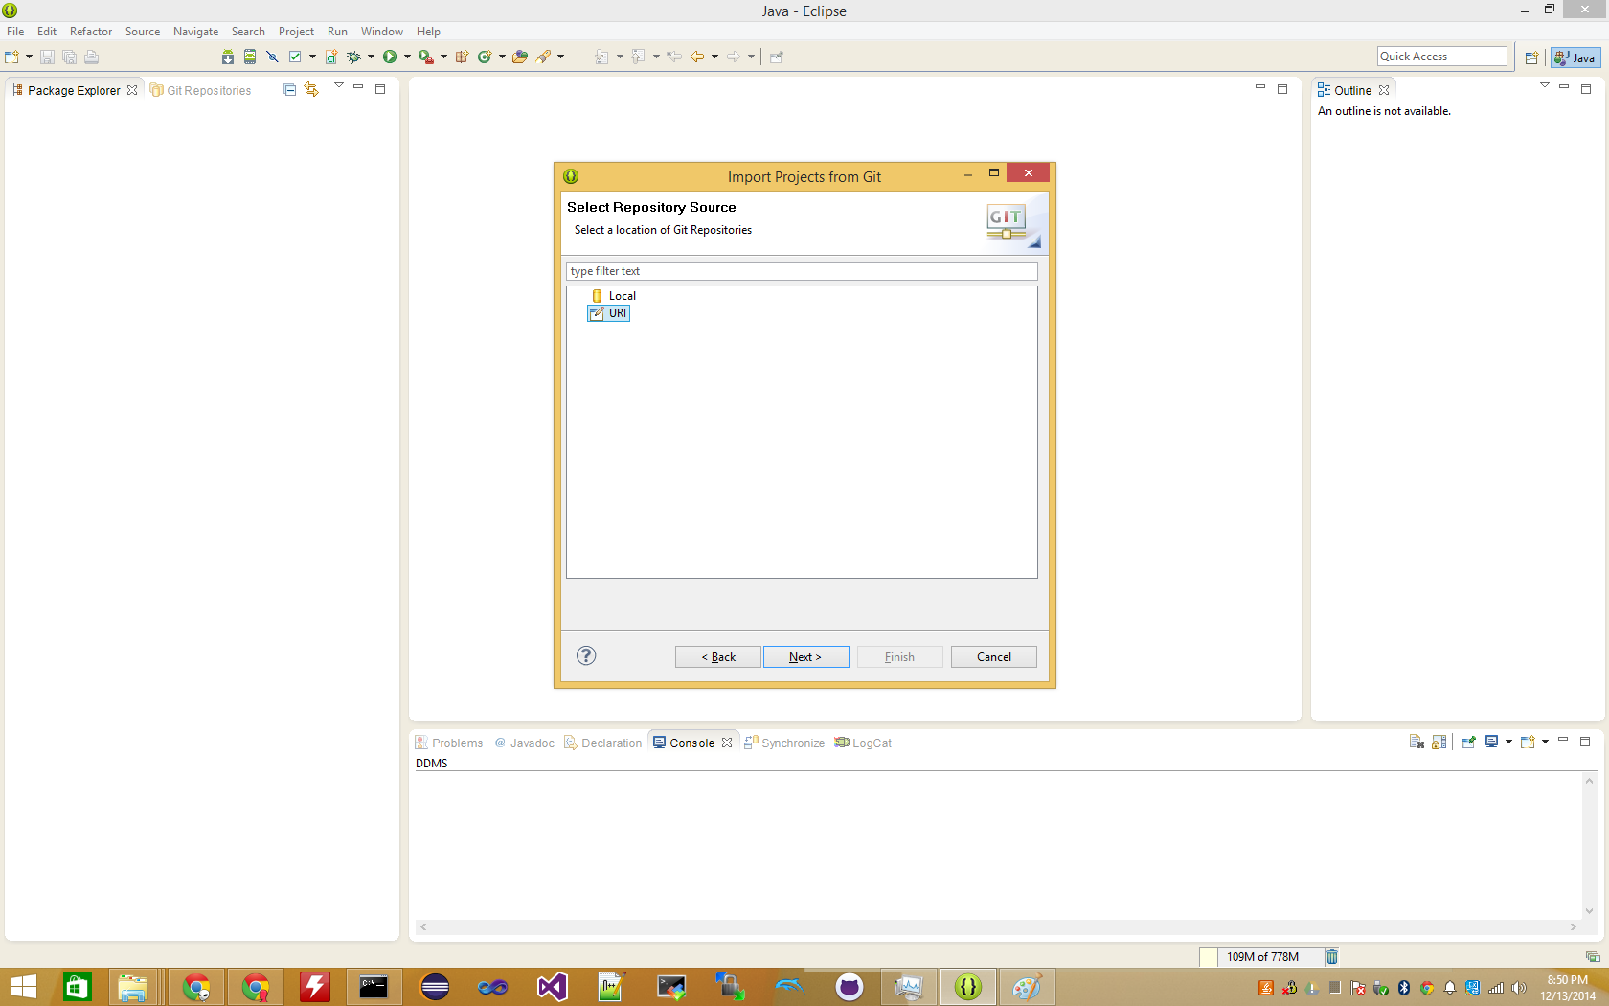

Slide 6
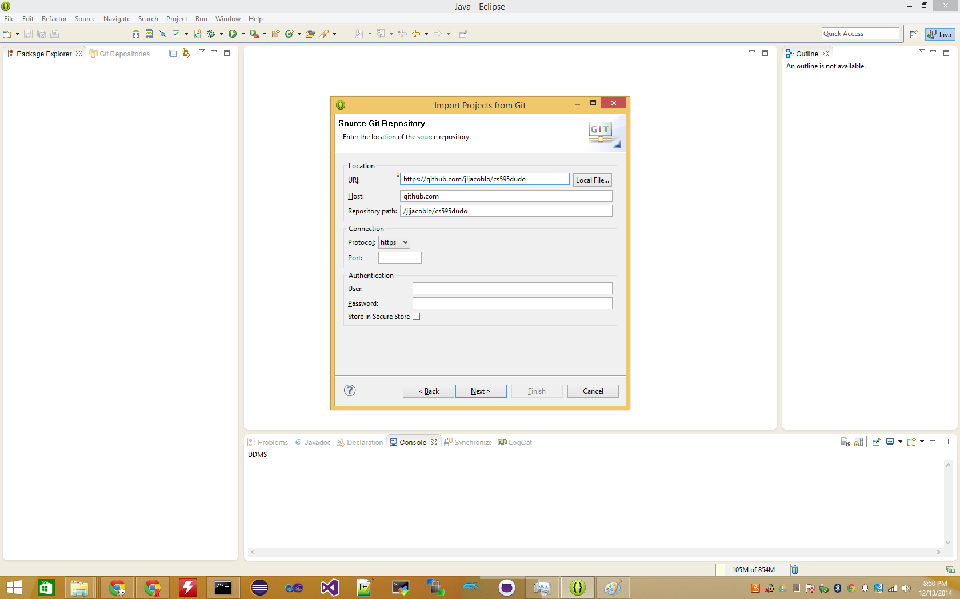

Slide 7
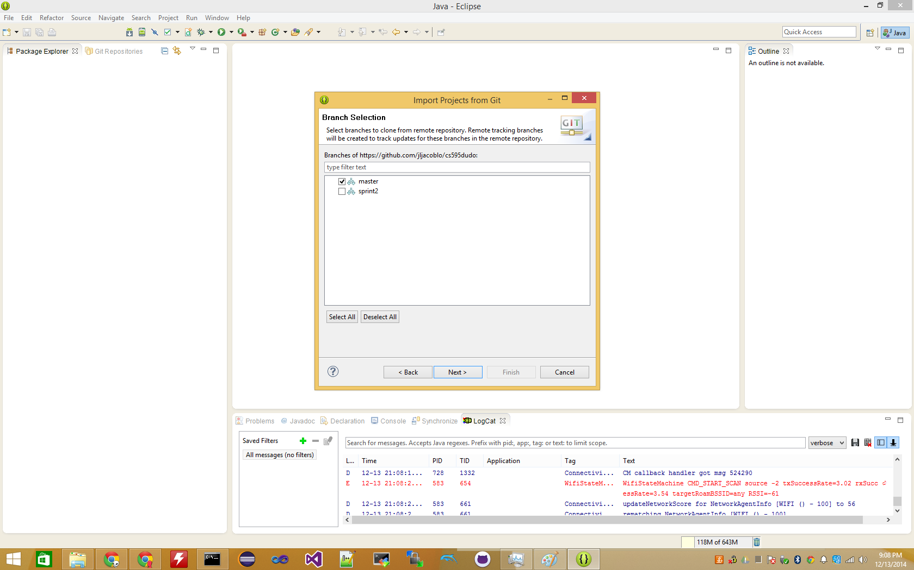

Slide 8
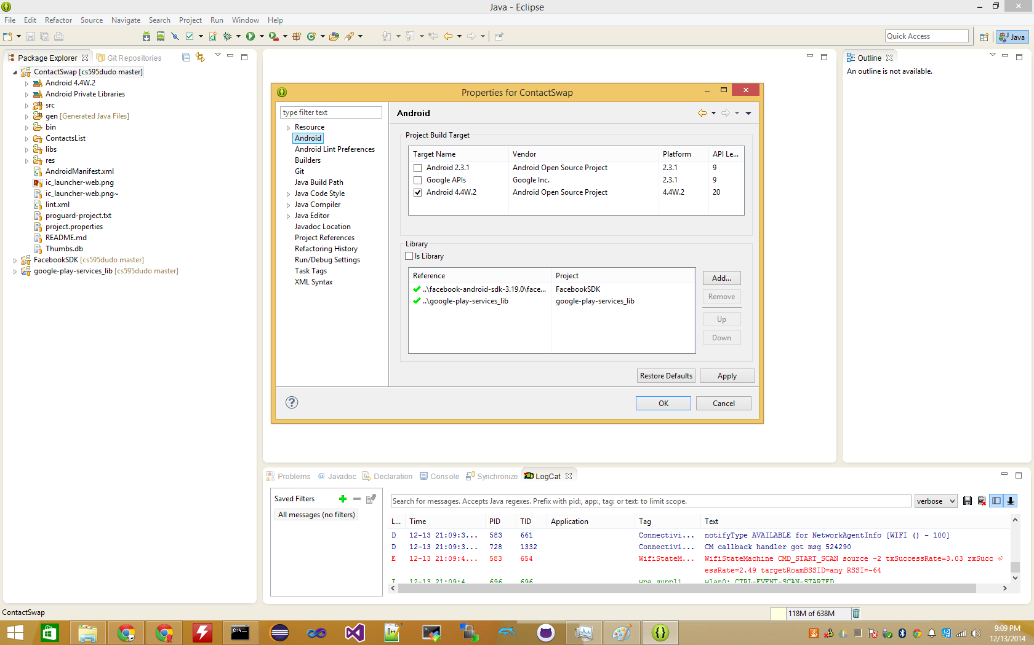

Slide 9
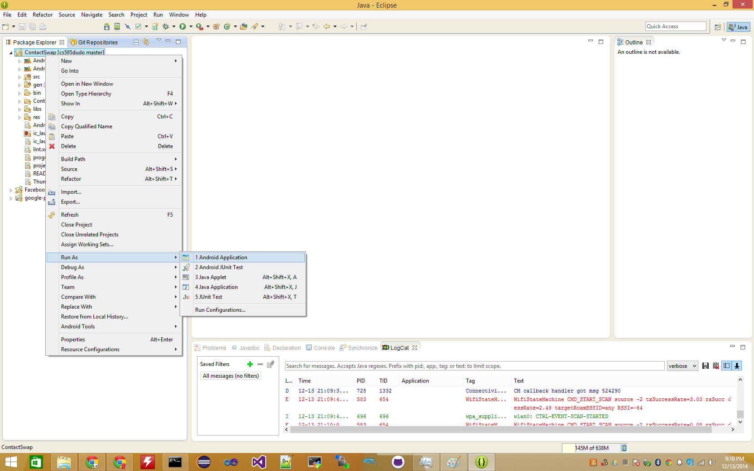
Notes:
choose Run As -> Android Application to run this Contact swap Application. It has to be on a physical Android device ( NFC functionality )

Slide 10
Installing The Application

Slide 11
Installing The Application
Download From:
<http://goo.gl/NPG3Bn>

Slide 12
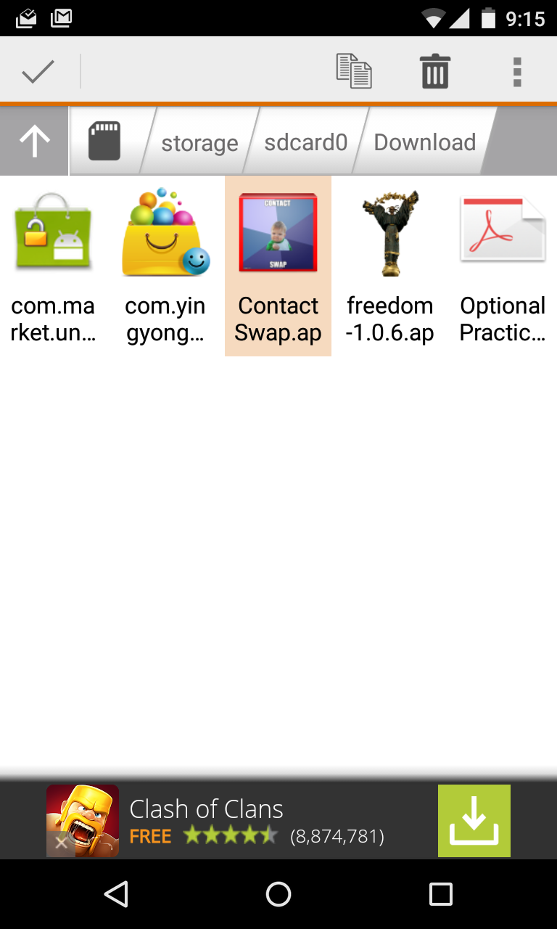
Installing The Application

Slide 13
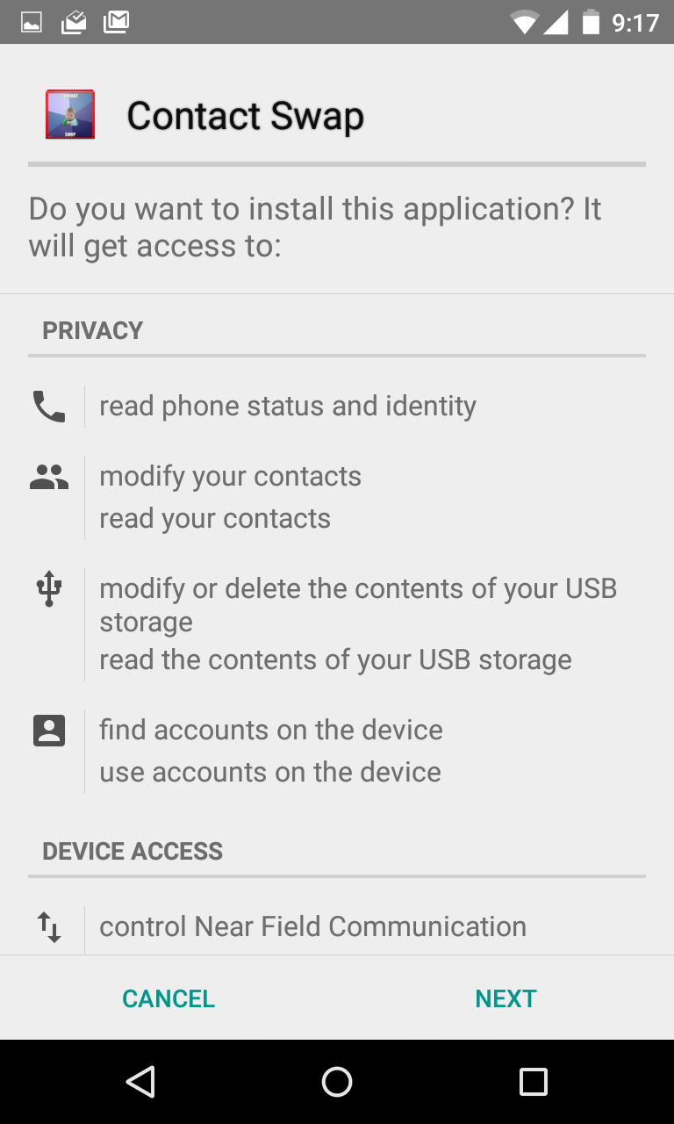
Installing The Application

Slide 14
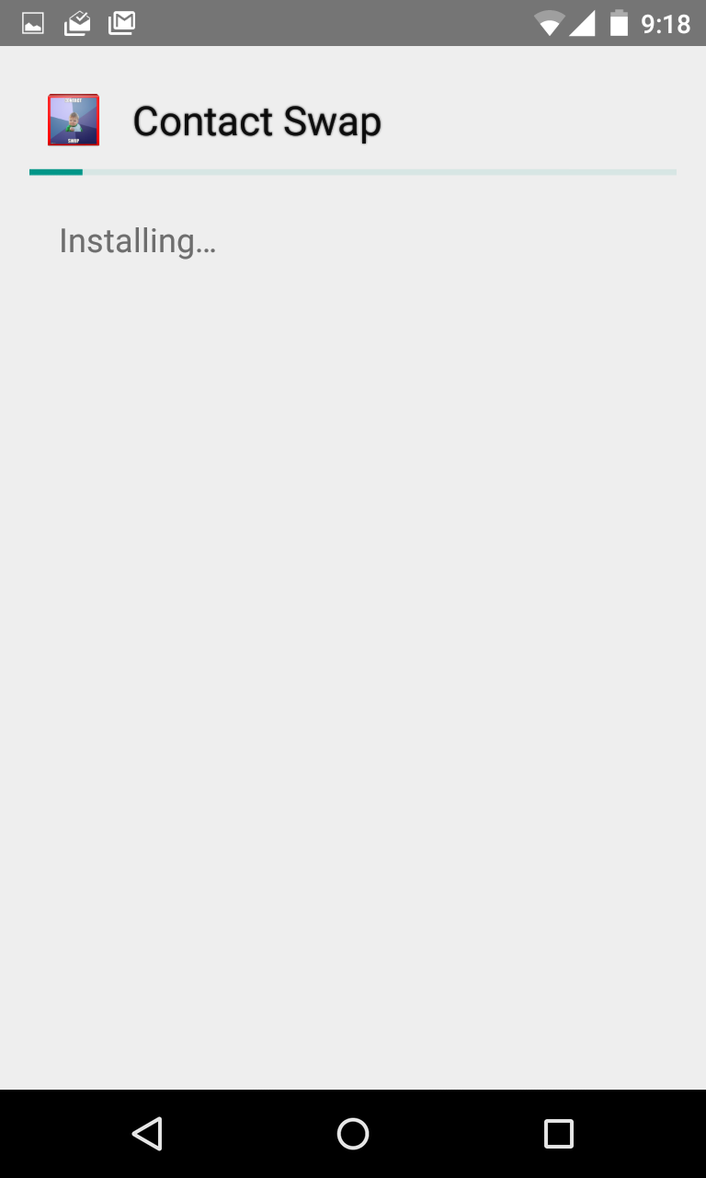
Installing The Application

Slide 15
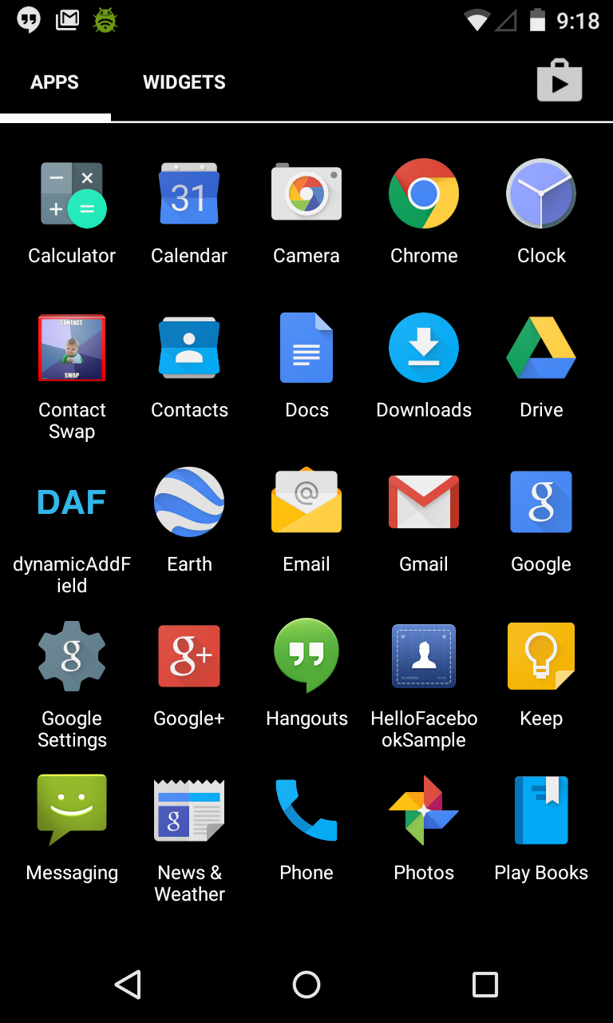
Installing The Application

Slide 16
Open The Application
Notes:
After installing the application, a new icon appears. select this icon to open the application

Slide 17
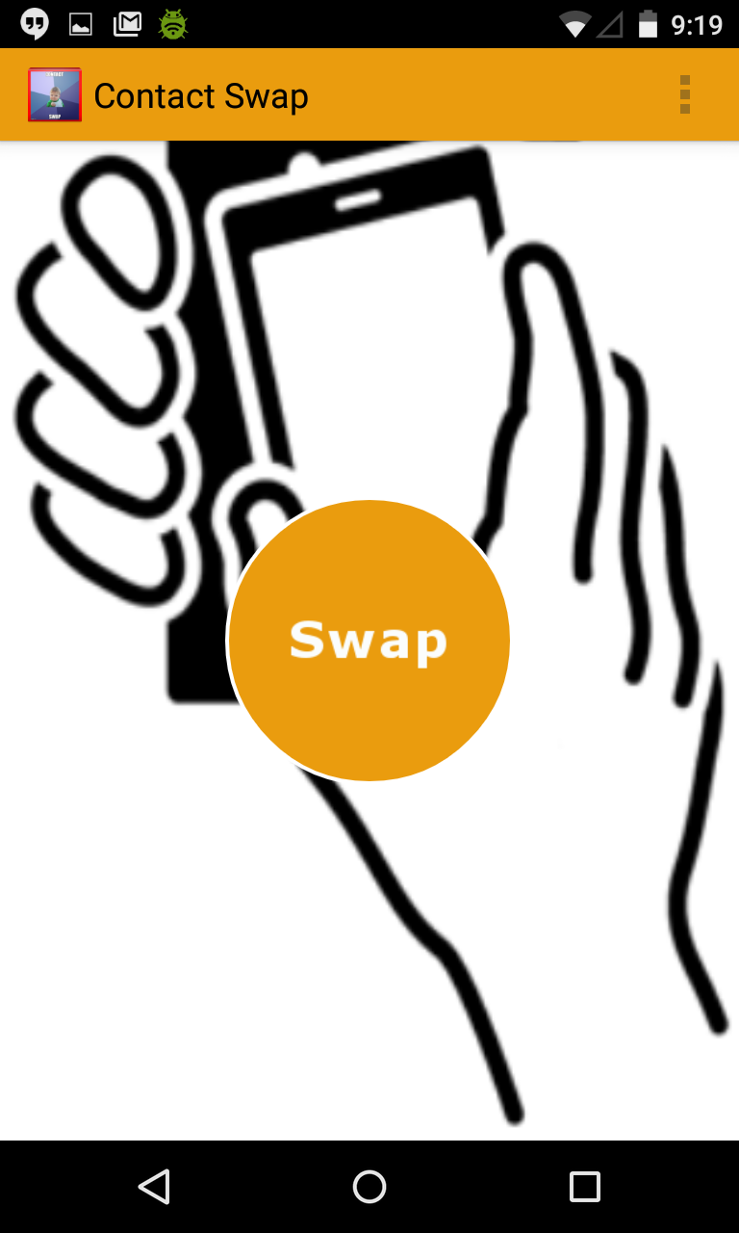
Main Activity

Slide 18
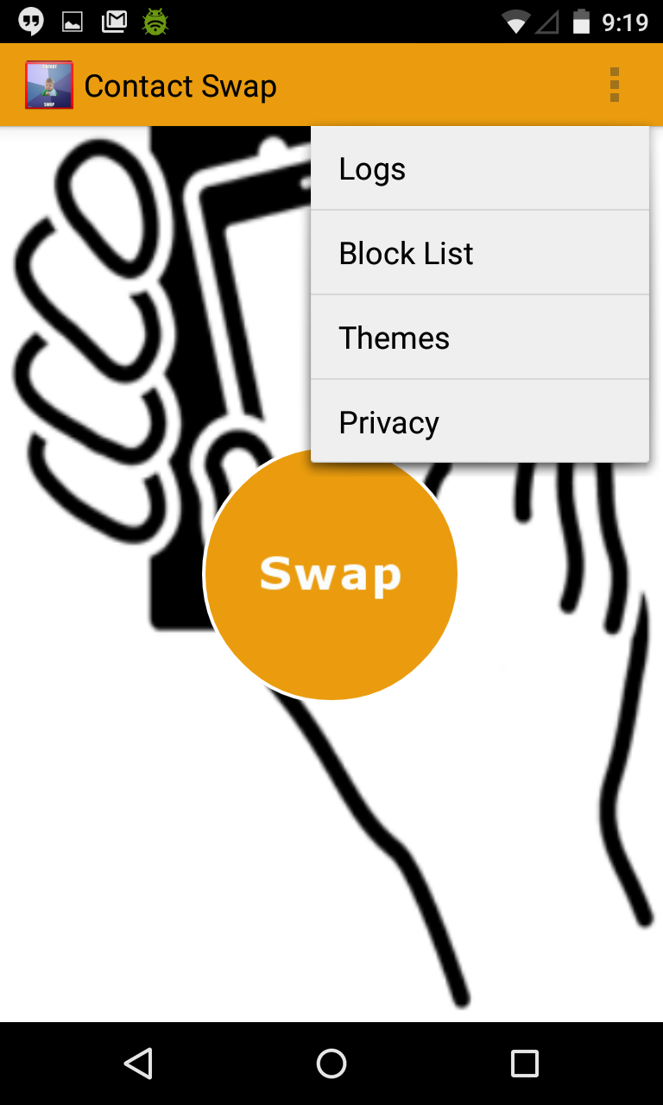
Menu Options

Slide 19
Privacy Activity

Slide 20
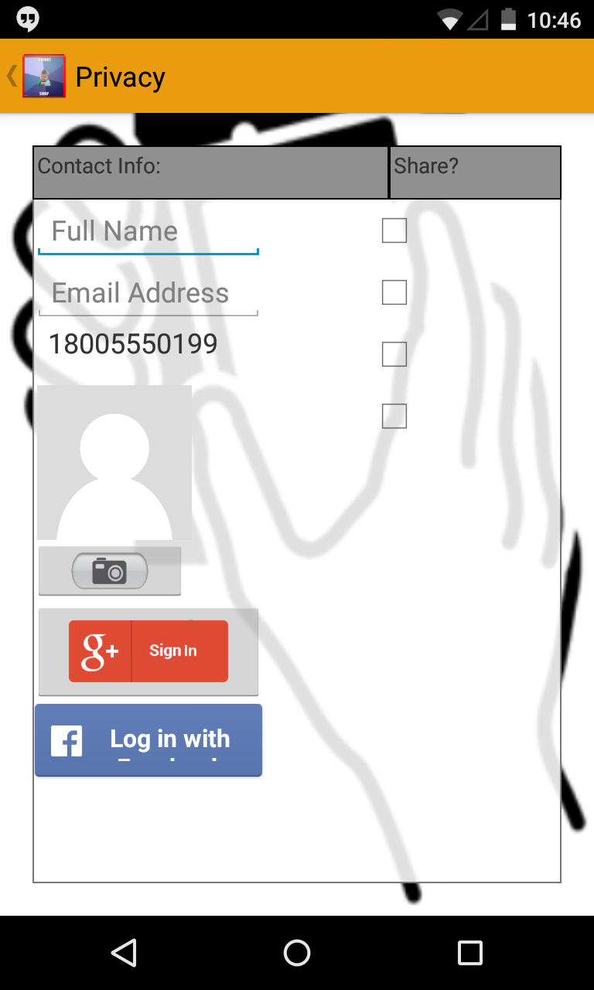
Privacy Activity

Slide 21
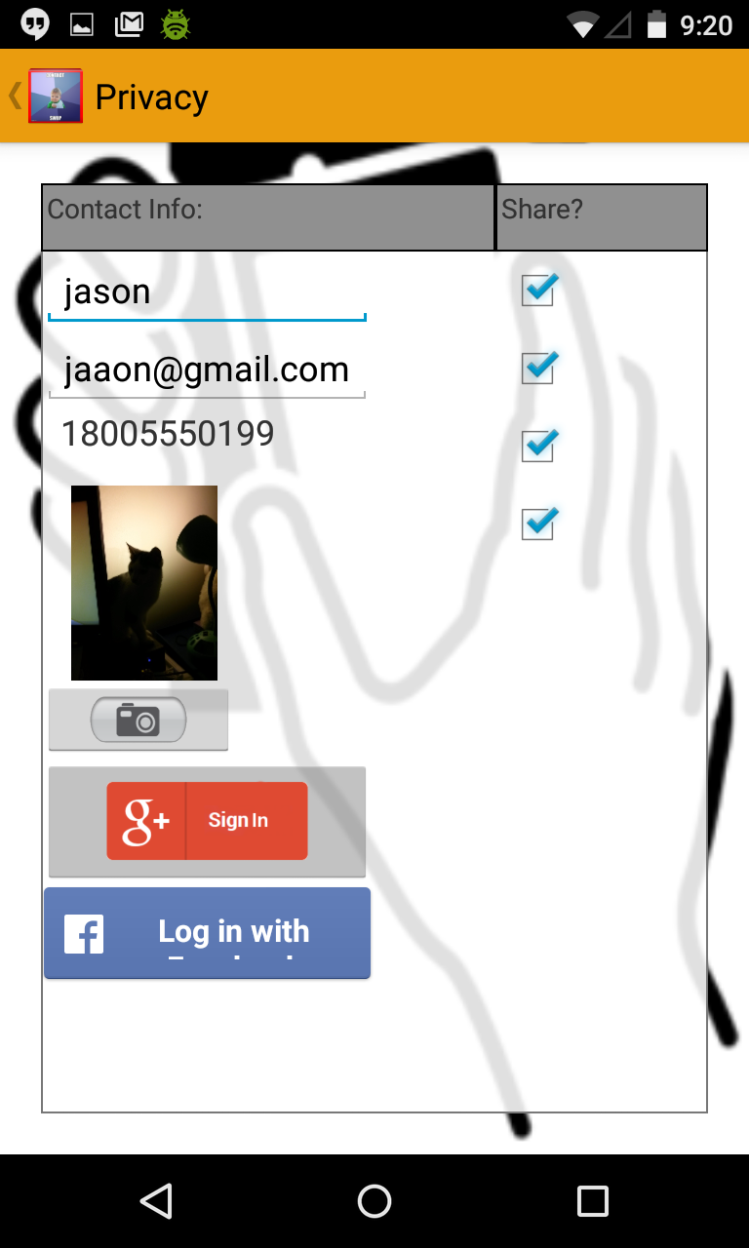
Privacy Activity
Edit Personal Info
Toggle shareability of fields

Slide 22
Privacy Activity ( Sign in to Google+ )

Slide 23
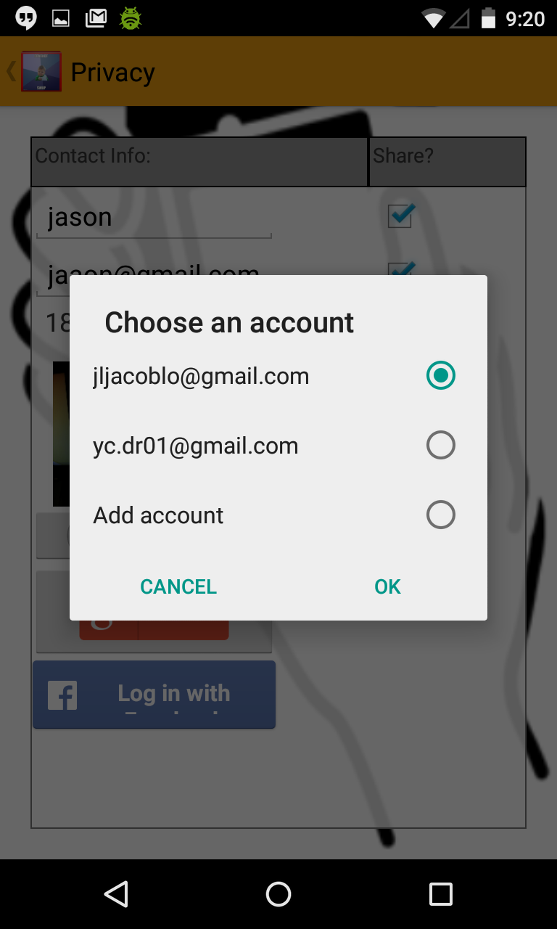
Privacy Activity ( Sign in to Google+ )

Slide 24
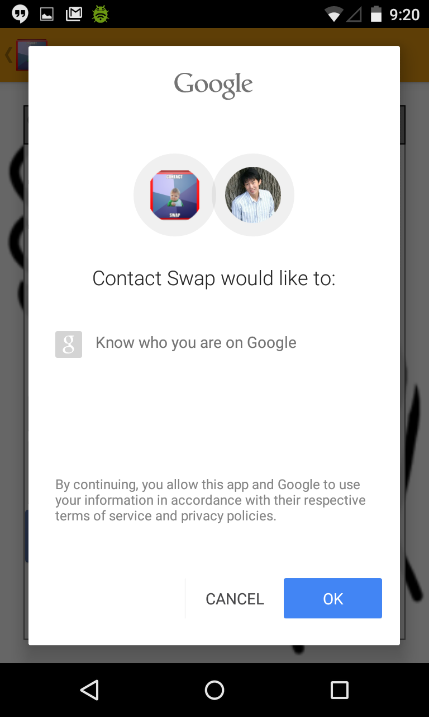
Privacy Activity ( Sign in to Google+ )

Slide 25
Privacy Activity ( Sign in to Facebook)

Slide 26
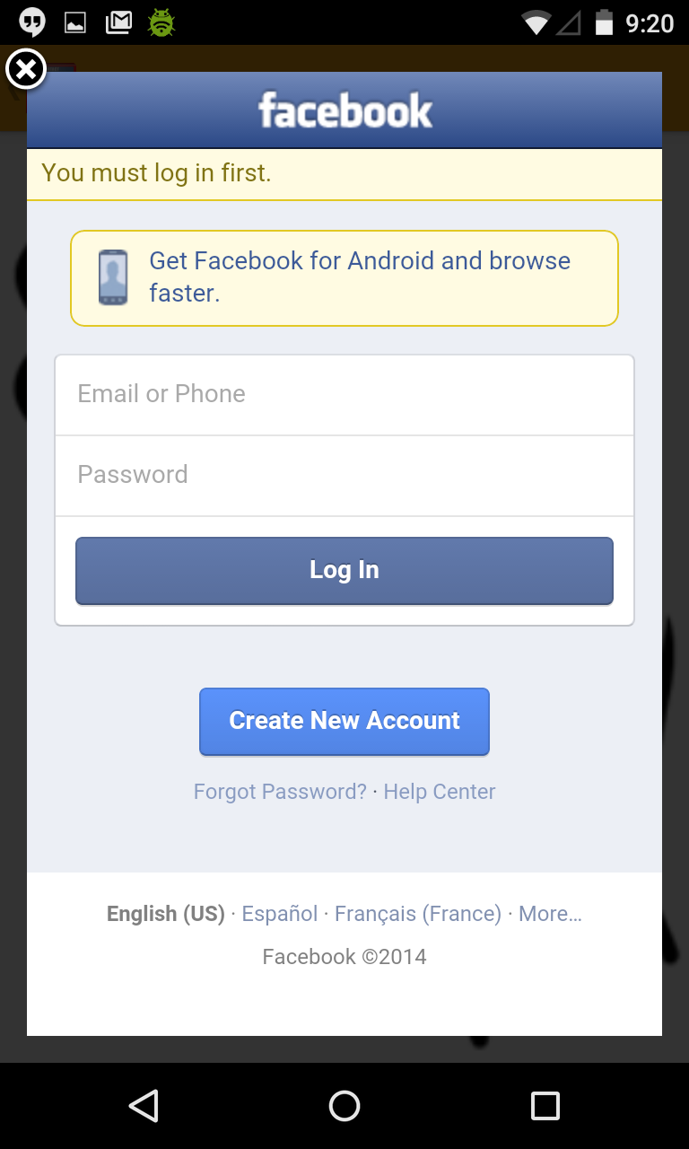
Privacy Activity ( Sign in to Facebook)

Slide 27
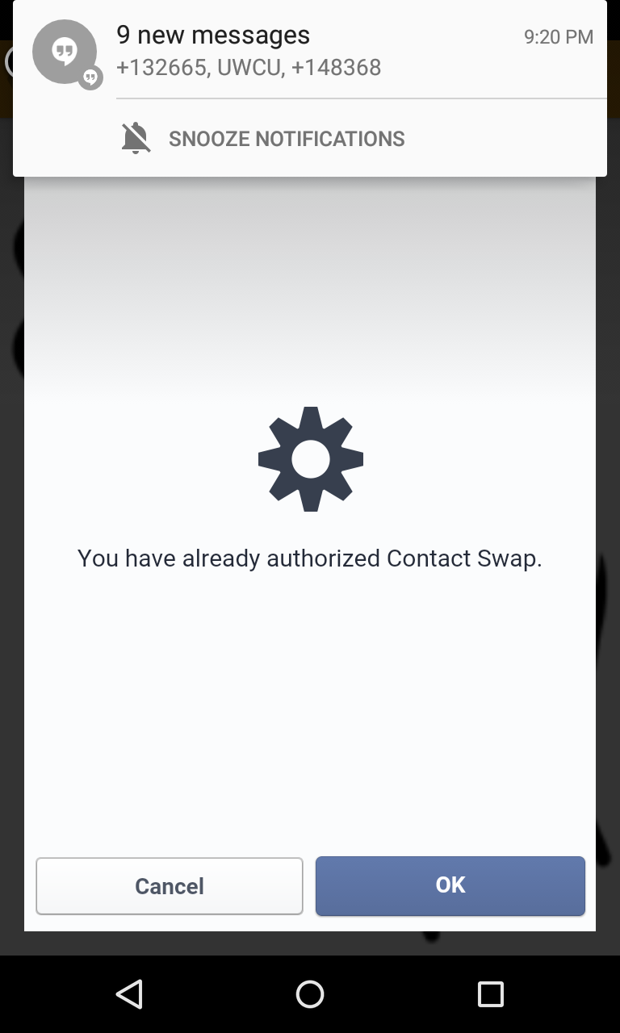
Privacy Activity ( Sign in to Facebook)

Slide 28
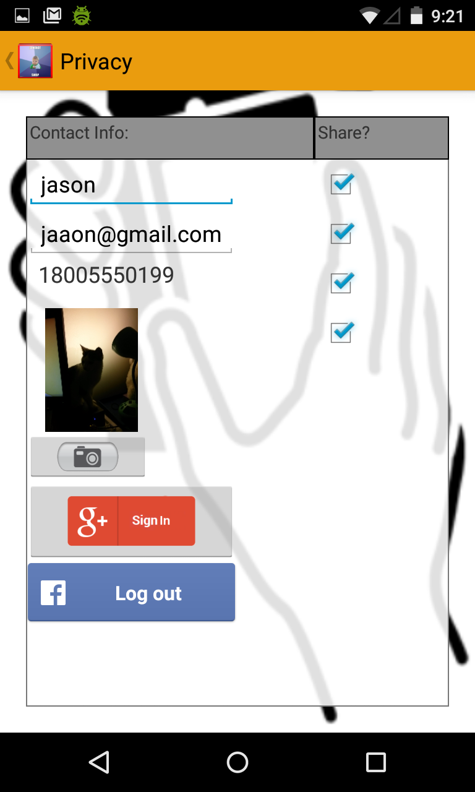
Privacy Activity ( Sign in to Facebook)

Slide 29
Privacy Activity ( Sign in to Facebook)

Slide 30
Swapping Contacts

Slide 31
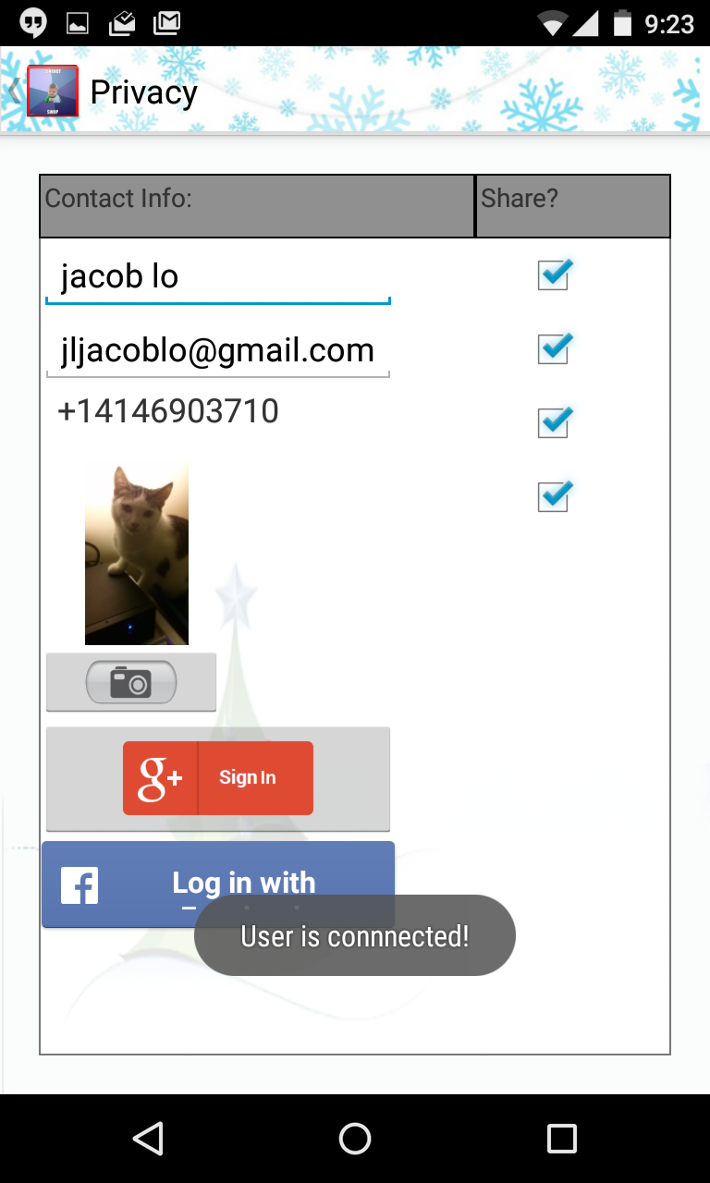
Privacy settings before swap
Phone 1
Phone 2

Slide 32
Main Activity: Swap in Progress

Slide 33
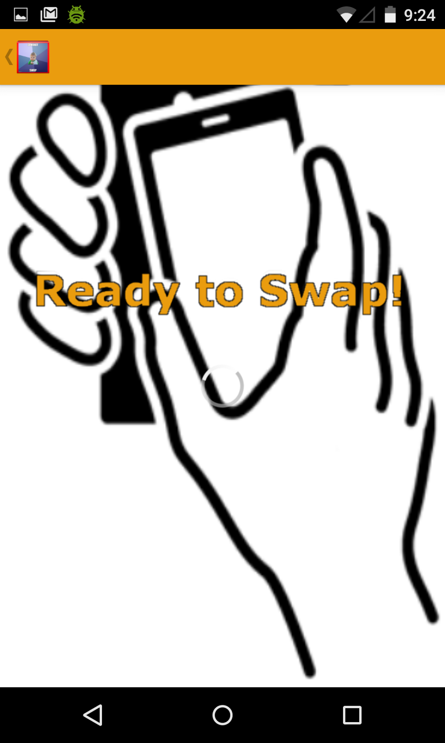
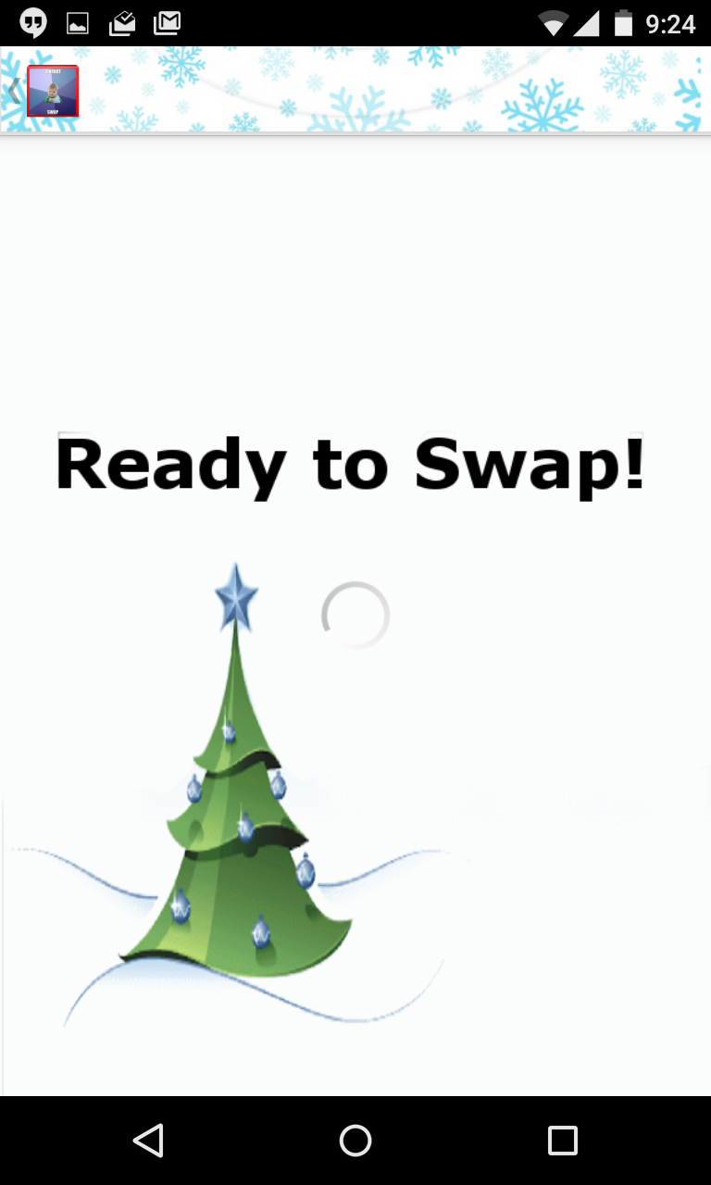
Phone 1 Phone 2

Slide 34
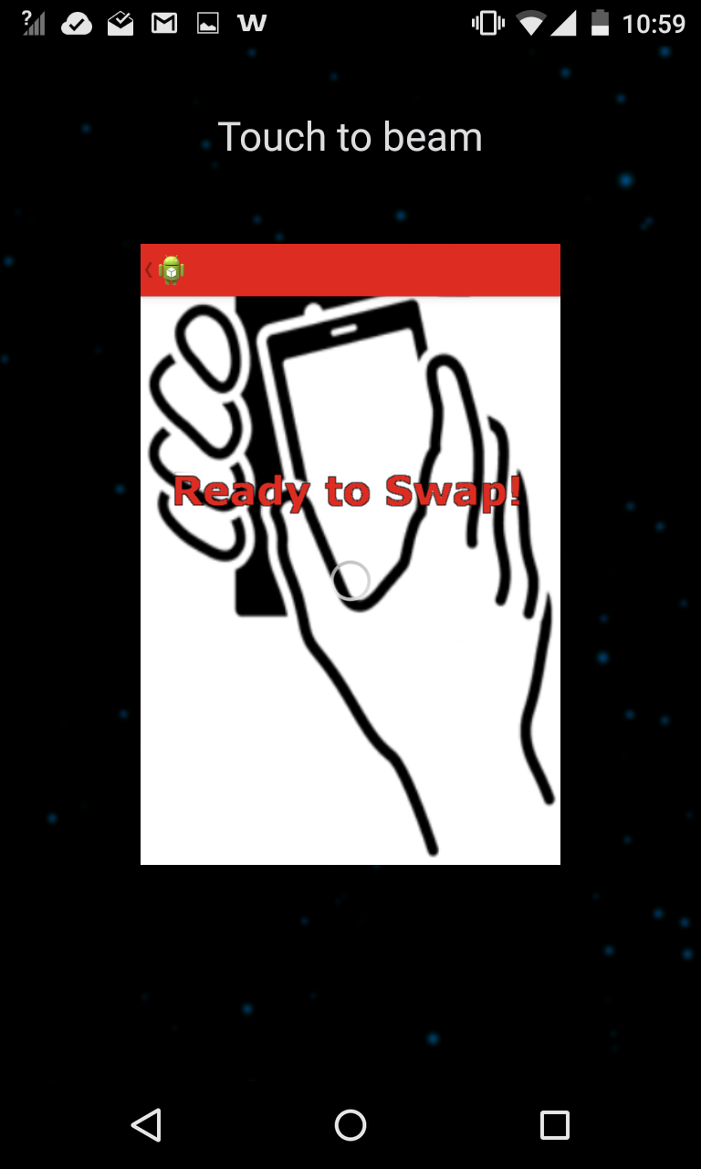
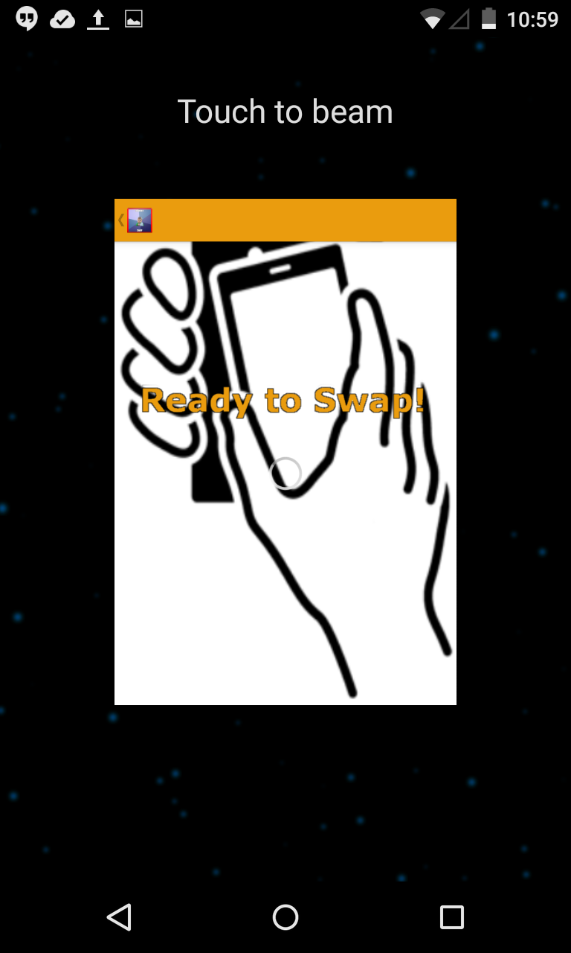
Phone 1 Phone 2

Slide 35
Contact Received

Slide 36
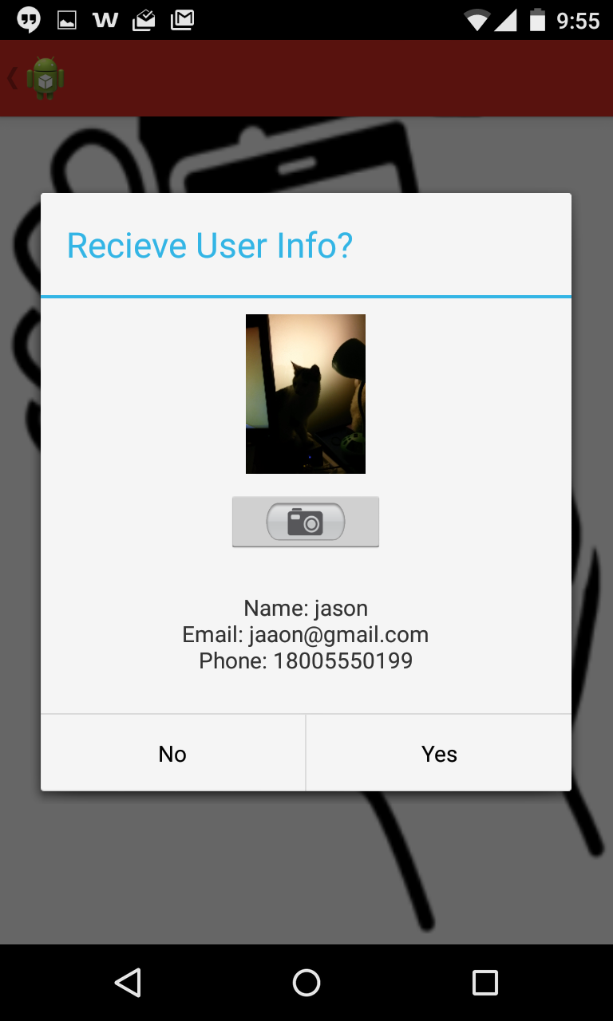
Contact Received
New Contact

Slide 37
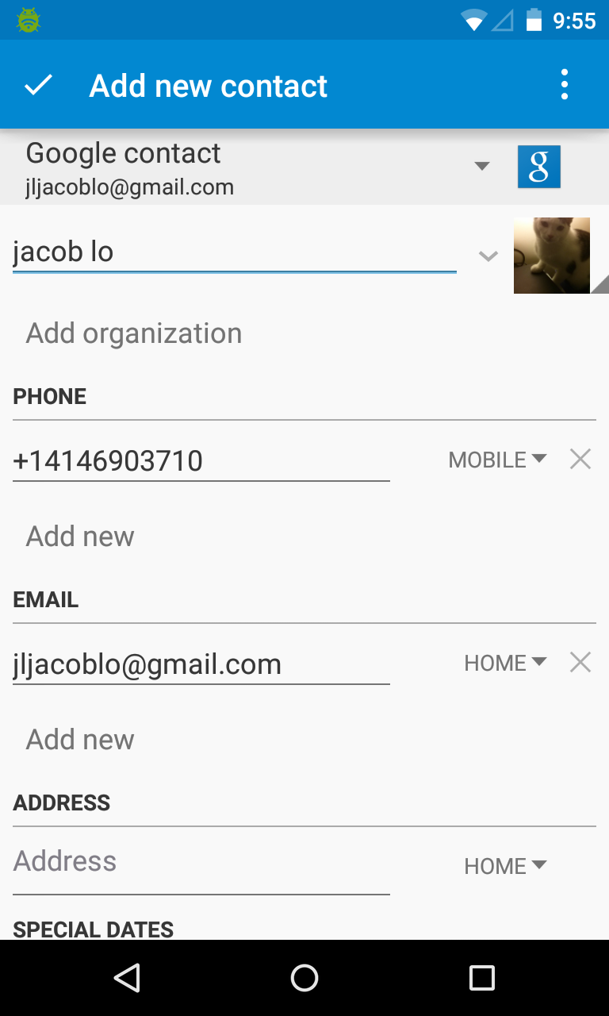
Contact Received

Slide 38
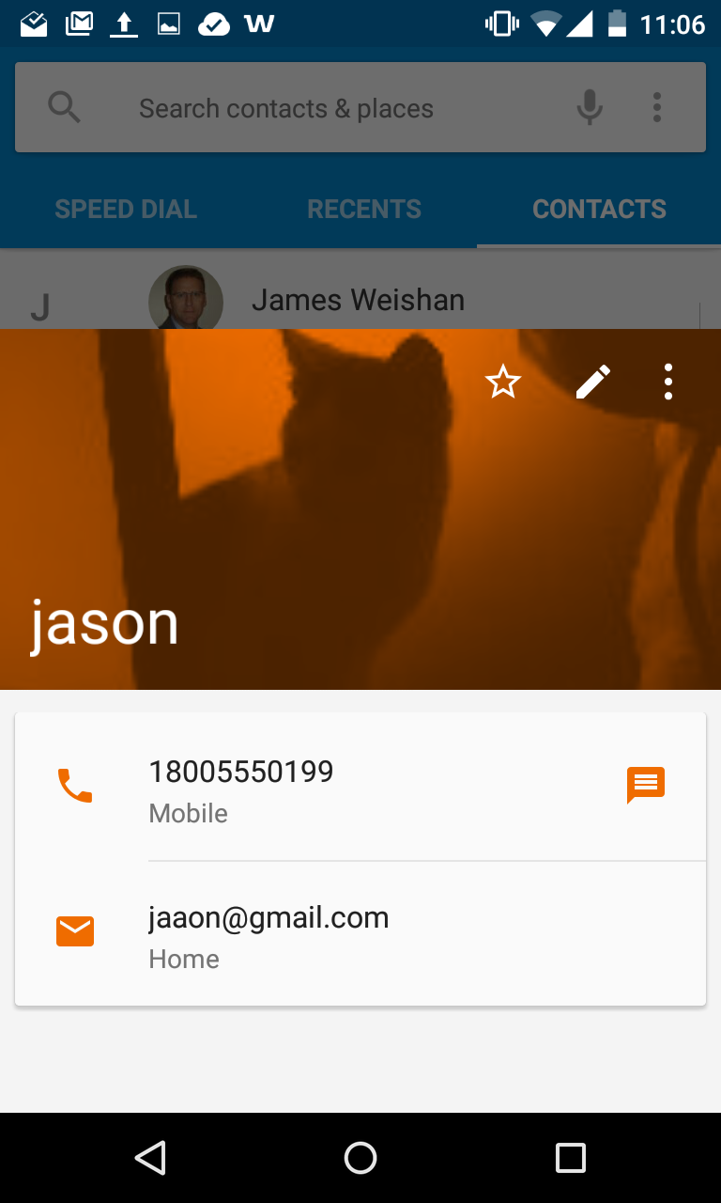
Contact Received

Slide 39
Swapping Contacts: Example 2

Slide 40
Privacy setting between phones before swap

Slide 41
Main Activity: Swap in Progress

Slide 42
Main Activity: Swap in Progress

Slide 43
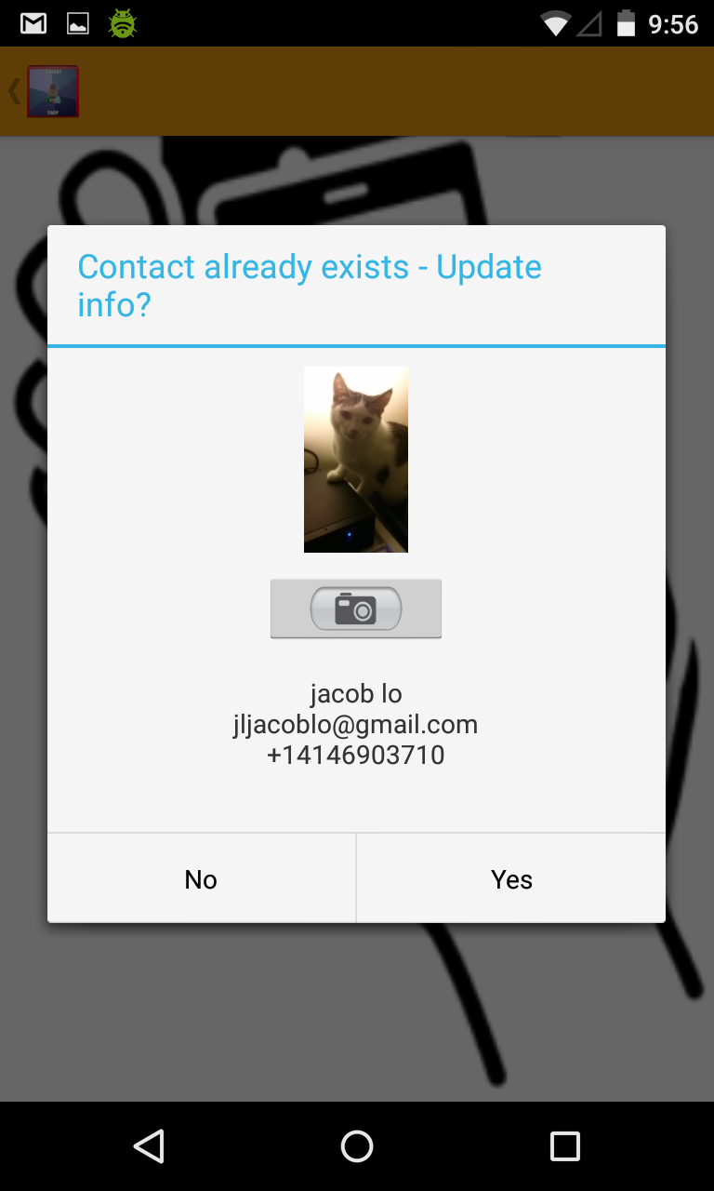
Main Activity: Swap in Progress
Contact Already Exists

Slide 44
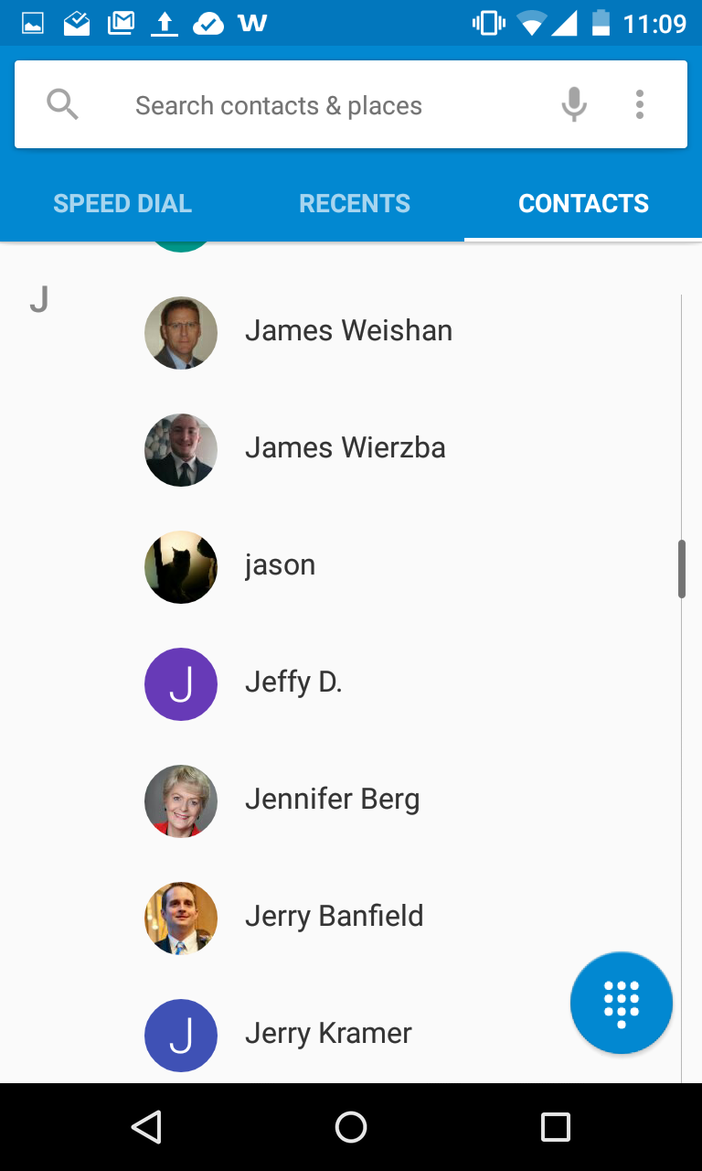
Main Activity: Swap in Progress

Slide 45
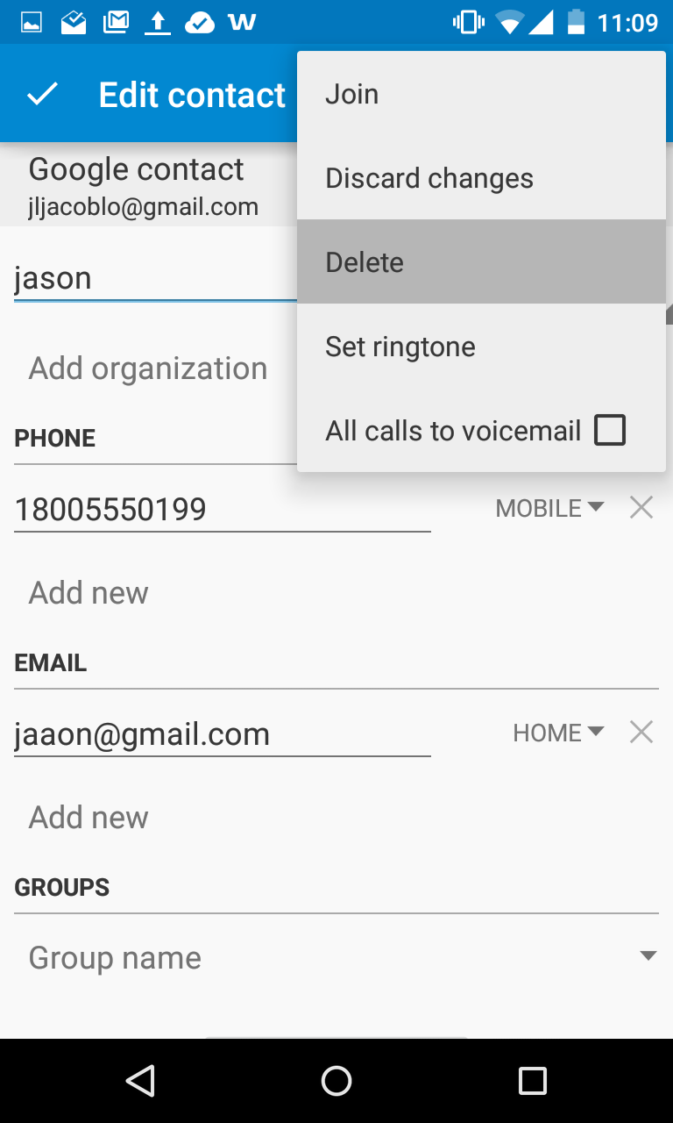
Main Activity: Swap in Progress

Slide 46
Swapping Contacts: Example 3

Slide 47
Privacy setting between phones before swap

Slide 48
Main Activity: Swap in Progress

Slide 49
Main Activity: Swap in Progress

Slide 50
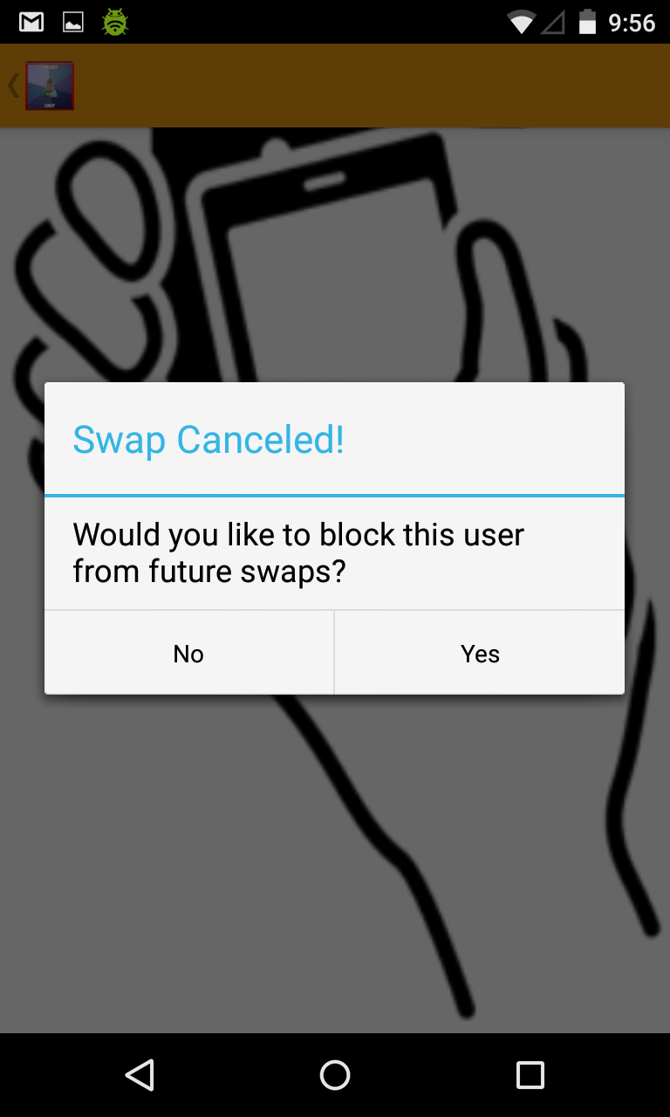
Main Activity: Block User

Slide 51
Main Activity: Block User

Slide 52
Viewing The Block List

Slide 53
Block List: View List

Slide 54
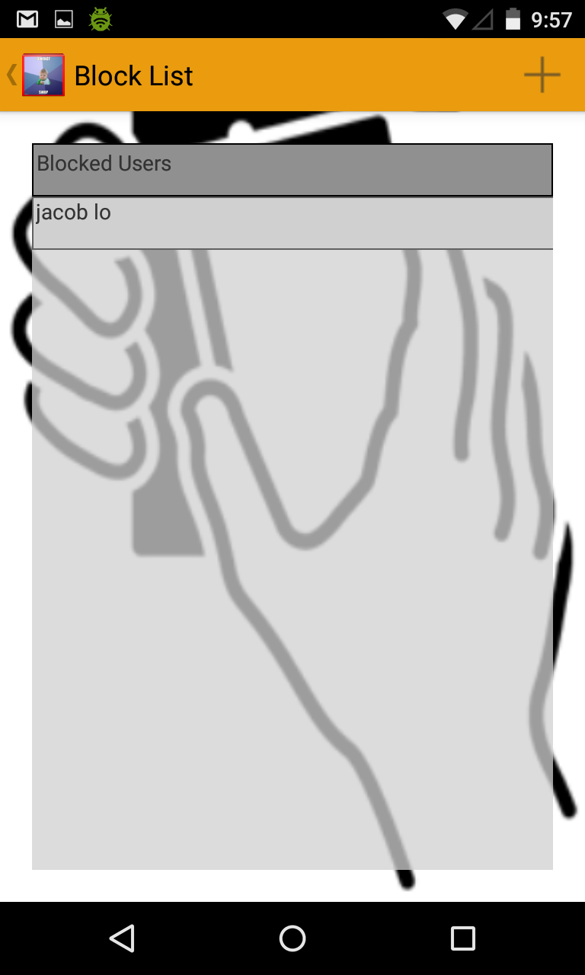
Block List: View List

Slide 55
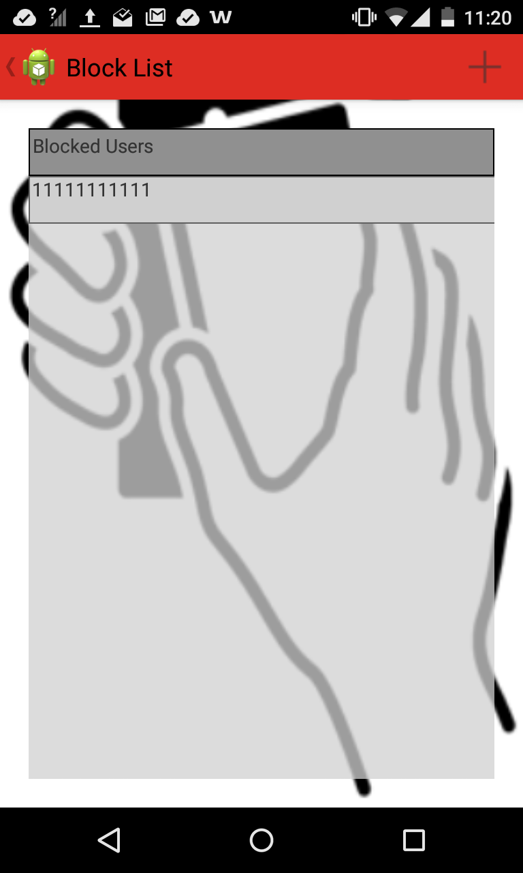
Block List: Remove Entry
Long-Press on Entry

Slide 56
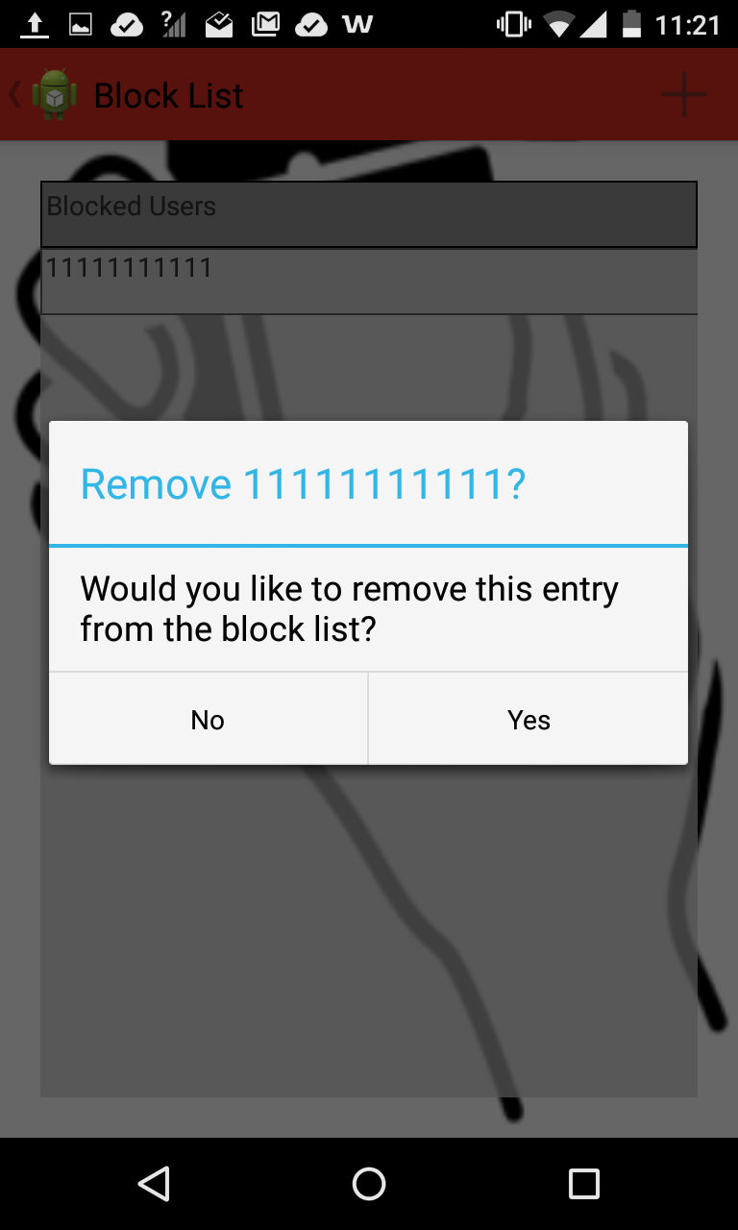
Block List: Remove Entry

Slide 57
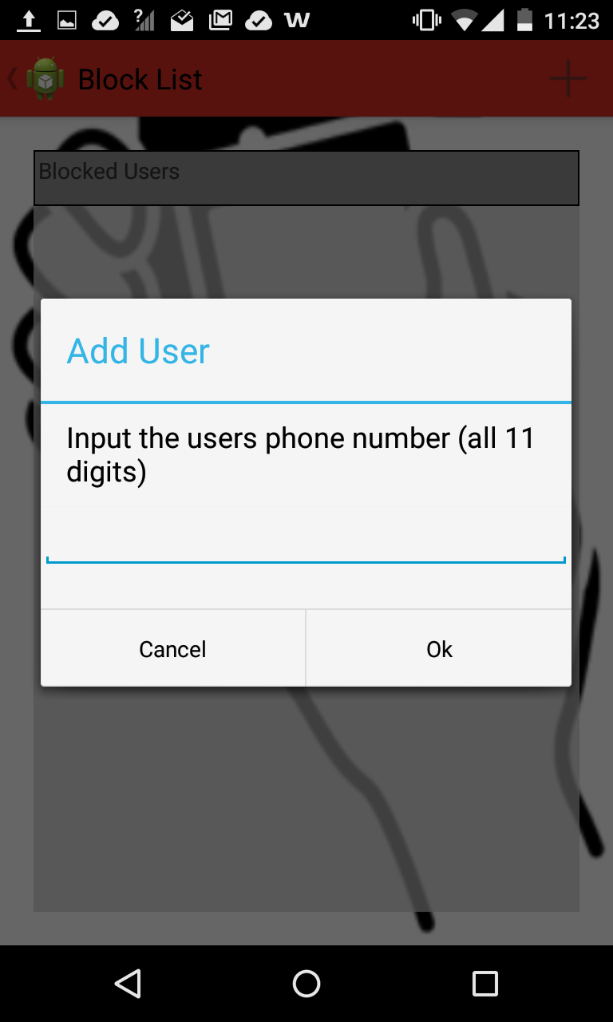
Block List: Add Entry

Slide 58
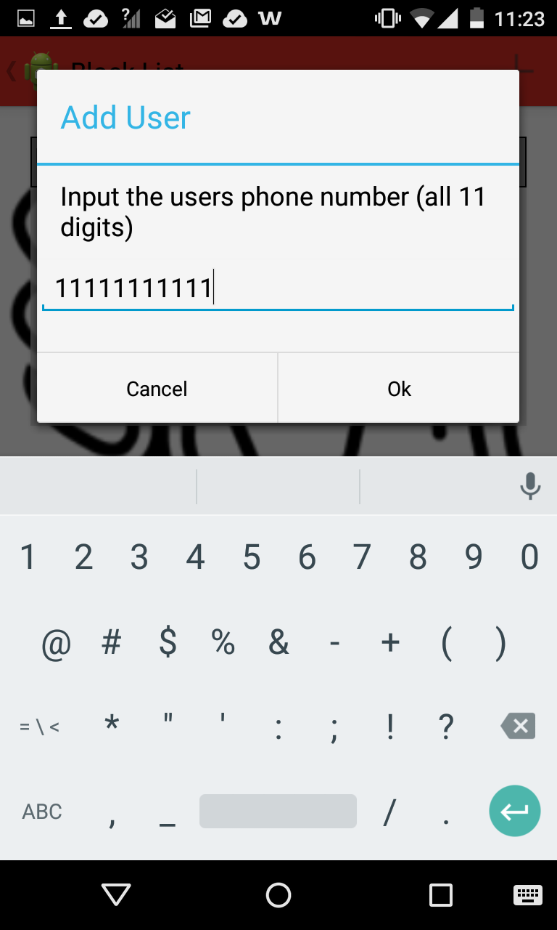
Block List: Add Entry

Slide 59

Block List: Add Entry

Slide 60
Viewing Swap Logs

Slide 61
View Logs

Slide 62
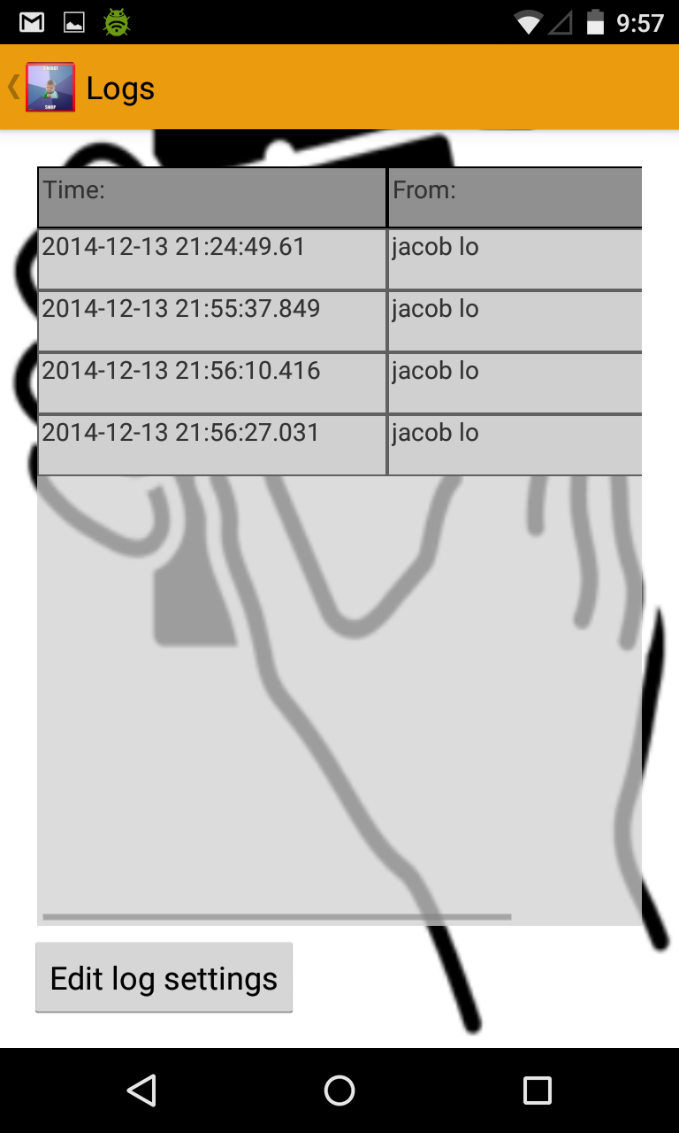
View Logs

Slide 63
View Logs

Slide 64

View Logs
Time Sort

Slide 65
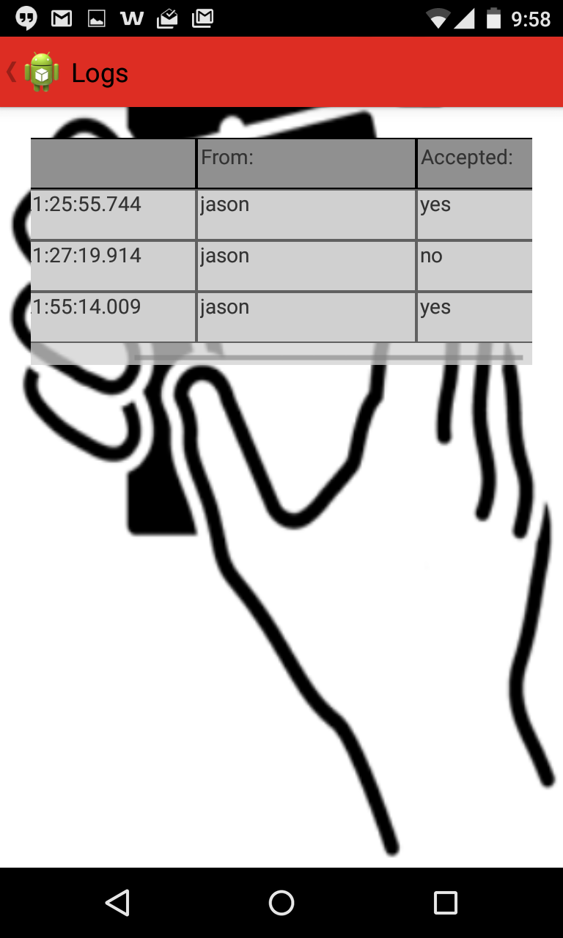
View Logs
Scroll right for more info

Slide 66
Changing the Theme

Slide 67
Change Theme

Slide 68
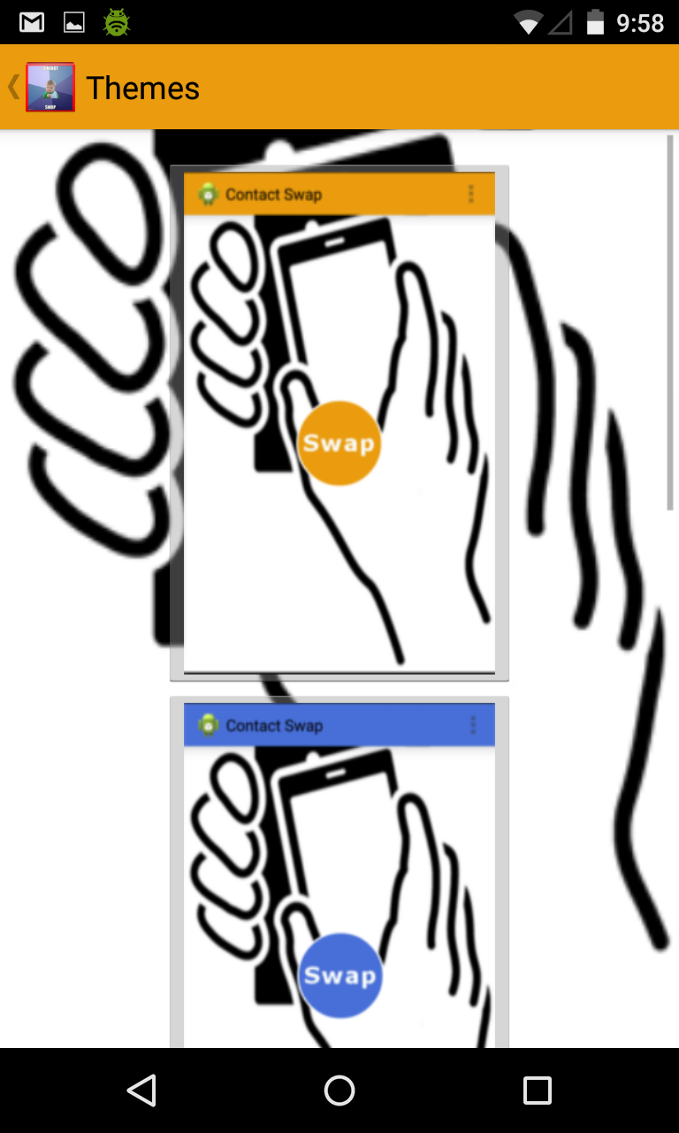
Change Theme

Slide 69
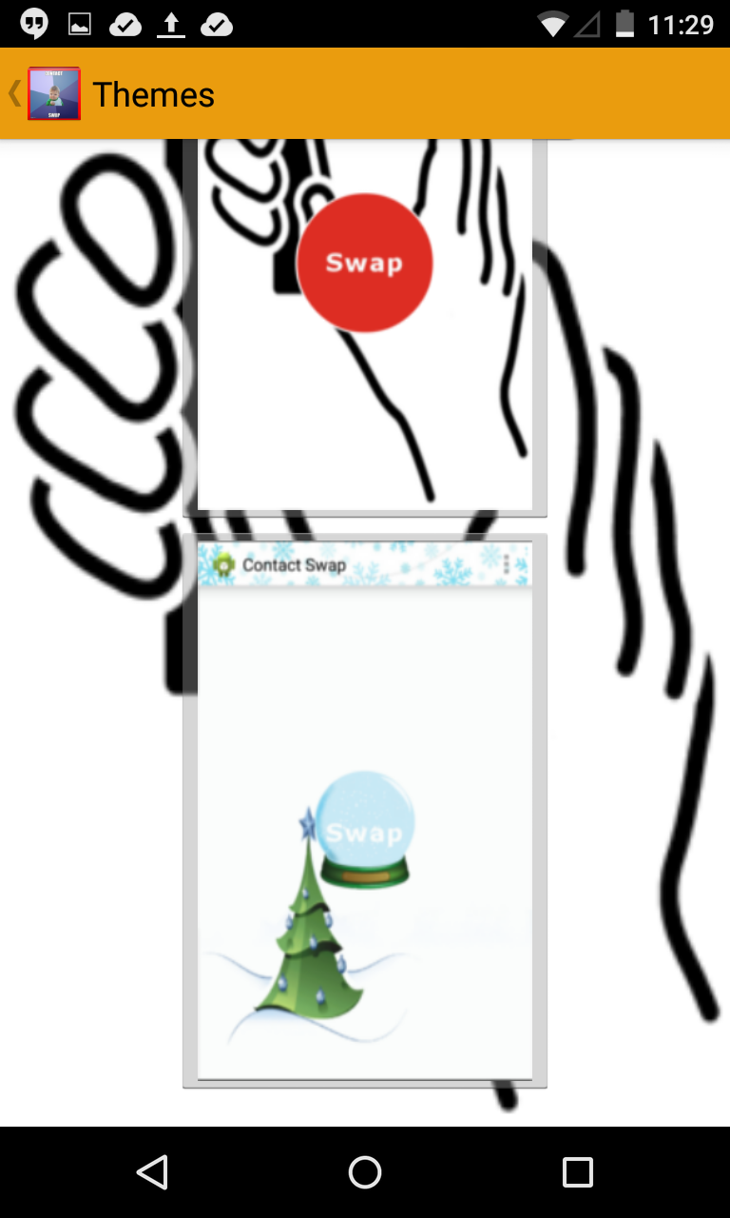
Change Theme

Slide 70
Change Theme

Slide 71
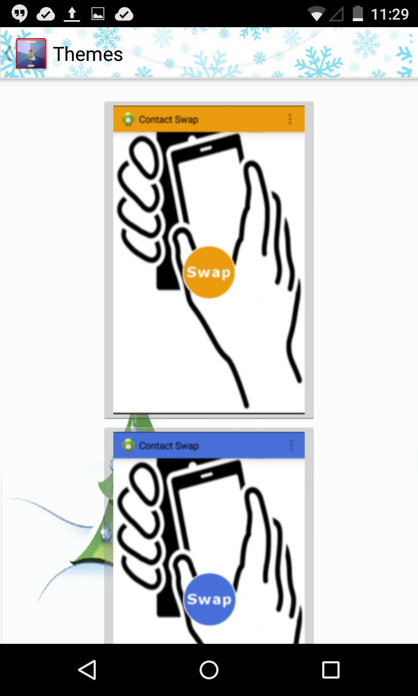
Change Theme

Slide 72
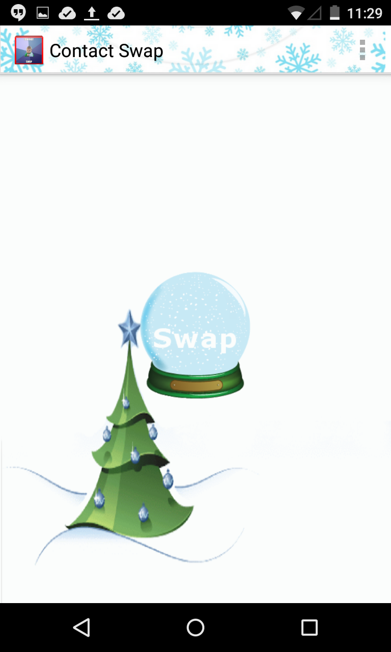
Change Theme : Main Activity

Slide 73
Thanks for Watching!

Slide 74
Contact Swap
Capstone Project 2014
<http://goo.gl/NPG3Bn>
Michael Haufe <mlhaufe@uwm.edu>
Anthonie Roux <aroux@uwm.edu>
Sean McClanahan <mcclana5@uwm.edu>
Kwok-ho Lo <kwokholo@uwm.edu>

